Slide 1
Introduction to Data Querying Using lodash
Kerry Ritter www.kerryritter.com
Node.jSTL ritter@kerryritter.com
January 14, 2016 Twitter: @kerryritter

Slide 2
What is lodash?
“A modern JavaScript utility library delivering consistency, modularity, performance, & extras.”
Methods for data querying and object transformations
.NET developer? You’ll see similarities to LINQ
The most depended-upon package in NPM

Slide 3
Why use lodash?
Faster development and (typically) more legible code
Safety, less bugs (== and === fun)
Why not underscore?
lodash seems to have a larger community
lodash has more methods
underscore is merging into lodash in the future

Slide 4
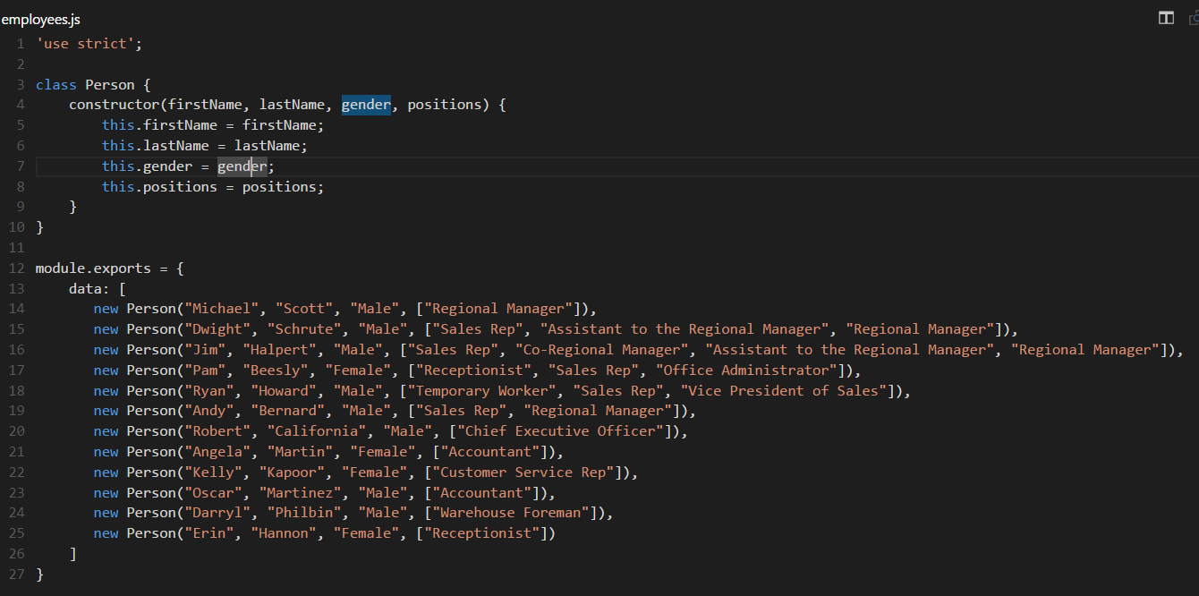

Examples

Slide 5
Examples: Grouping by Property
Code:
var employees = require("./employees").data;
var _ = require("lodash");
var genderGroups = _.groupBy(employees, "gender");
console.log(genderGroups);
Output:
{
Male:
[
Person { firstName: 'Michael', lastName: 'Scott', gender: 'Male', positions: [Array] },
Person { firstName: 'Dwight', lastName: 'Schrute', gender: 'Male', positions: [Array] },
Person { firstName: 'Jim', lastName: 'Halpert', gender: 'Male', positions: [Array] },
Person { firstName: 'Ryan', lastName: 'Howard', gender: 'Male', positions: [Array] },
Person { firstName: 'Andy', lastName: 'Bernard', gender: 'Male', positions: [Array] },
Person { firstName: 'Robert', lastName: 'California', gender: 'Male', positions: [Array] },
Person { firstName: 'Oscar', lastName: 'Martinez', gender: 'Male', positions: [Array] },
Person { firstName: 'Darryl', lastName: 'Philbin', gender: 'Male', positions: [Array] }
],
Female:
[
Person { firstName: 'Pam', lastName: 'Beesly', gender: 'Female', positions: [Array] },
Person { firstName: 'Angela', lastName: 'Martin', gender: 'Female', positions: [Array] },
Person { firstName: 'Kelly', lastName: 'Kapoor', gender: 'Female', positions: [Array] },
Person { firstName: 'Erin', lastName: 'Hannon', gender: 'Female', positions: [Array] }
]
}

Slide 6
Examples: Grouping by Lambda
Output:
{
S:
[ Person { firstName: 'Michael', lastName: 'Scott', gender: 'Male', positions: [Array] },
Person { firstName: 'Dwight', lastName: 'Schrute', gender: 'Male', positions: [Array] } ],
H:
[ Person { firstName: 'Jim', lastName: 'Halpert', gender: 'Male', positions: [Array] },
Person { firstName: 'Ryan', lastName: 'Howard', gender: 'Male', positions: [Array] },
Person { firstName: 'Erin', lastName: 'Hannon', gender: 'Female', positions: [Array] } ],
B:
[ Person { firstName: 'Pam', lastName: 'Beesly', gender: 'Female', positions: [Array] },
Person { firstName: 'Andy', lastName: 'Bernard', gender: 'Male', positions: [Array] } ],
C:
[ Person { firstName: 'Robert', lastName: 'California', gender: 'Male', positions: [Array] } ],
...
}
Code:
var employees = require("./employees").data;
var _ = require("lodash");
var groupedByLastName = _.groupBy(employees, function(employee) {
return employee.lastName[0];
});
console.log(groupedByLastName);

Slide 7
Examples: Find()
Output:
Person { firstName: 'Michael', lastName: 'Scott', gender: 'Male', positions: [Array] }
Output:
undefined
Code:
var employees = require("./employees").data;
var _ = require("lodash");
var michaelScott = _.find(employees,
{ firstName: "Michael", lastName: "Scott" });
console.log(michaelScott);
Code:
var employees = require("./employees").data;
var _ = require("lodash");
var toby = _.find(employees,
{ firstName: "Toby", lastName: "Flenderson" });
console.log(toby);

Slide 8
Examples: Filter()
Output:
[
Person { firstName: 'Dwight', lastName: 'Schrute', gender: 'Male', positions: [ 'Sales Rep' ... ] },
Person { firstName: 'Jim', lastName: 'Halpert', gender: 'Male', positions: [ 'Sales Rep', ... ] },
Person { firstName: 'Pam', lastName: 'Beesly', gender: 'Female', positions: [ 'Sales Rep', ... ] },
Person { firstName: 'Ryan', lastName: 'Howard', gender: 'Male', positions: [ 'Sales Rep', ... ] },
Person { firstName: 'Andy', lastName: 'Bernard', gender: 'Male', positions: [ 'Sales Rep', ... ] }
]
Code:
var employees = require("./employees").data;
var _ = require("lodash");
var salesReps = _.filter(employees, function (employee) {
return _.includes(employee.positions, "Sales Rep");
});
console.log(salesReps);

Slide 9
Examples: Reject()
Output:
[
Person { firstName: 'Michael', lastName: 'Scott', gender: 'Male', positions: [ 'Regional Manager' ] },
Person { firstName: 'Robert', lastName: 'California', gender: 'Male', positions: [ ‘CEO' ] },
Person { firstName: 'Angela', lastName: 'Martin', gender: 'Female', positions: [ 'Accountant' ] },
Person { firstName: 'Kelly', lastName: 'Kapoor', gender: 'Female', positions: [ 'Cust Service Rep' ] },
Person { firstName: 'Oscar', lastName: 'Martinez', gender: 'Male', positions: [ 'Accountant' ] },
Person { firstName: 'Darryl', lastName: 'Philbin', gender: 'Male', positions: [ ‘Foreman' ] },
Person { firstName: 'Erin', lastName: 'Hannon', gender: 'Female', positions: [ 'Receptionist' ] }
]
Code:
var employees = require("./employees").data;
var _ = require("lodash");
var notSalesReps = _.reject(employees, function (employee) {
return _.includes(employee.positions, "Sales Rep");
});
console.log(notSalesReps);

Slide 10
Examples: Map
Output:
[
{ name: 'Michael Scott', lastPosition: [ 'Regional Manager' ] },
{ name: 'Dwight Schrute', lastPosition: [ 'Regional Manager' ] },
{ name: 'Jim Halpert', lastPosition: [ 'Regional Manager' ] },
{ name: 'Pam Beesly', lastPosition: [ 'Office Administrator' ] },
{ name: 'Ryan Howard', lastPosition: [ 'Vice President of Sales' ] },
{ name: 'Andy Bernard', lastPosition: [ 'Regional Manager' ] },
{ name: 'Robert California', lastPosition: [ 'Chief Executive Officer' ] },
{ name: 'Angela Martin', lastPosition: [ 'Accountant' ] },
{ name: 'Kelly Kapoor', lastPosition: [ 'Customer Service Rep' ] },
{ name: 'Oscar Martinez', lastPosition: [ 'Accountant' ] },
{ name: 'Darryl Philbin', lastPosition: [ 'Warehouse Foreman' ] },
{ name: 'Erin Hannon', lastPosition: [ 'Receptionist' ] }
]
Code:
var employees = require("./employees").data;
var _ = require("lodash");
var viewModel = _.map(employees, function (employee) {
return {
name: employee.firstName + " " + employee.lastName,
lastPosition: _.takeRight(employee.positions, 1)
}
});
console.log(viewModel);

Slide 11
Examples: Map #2
Output:
[
'Scott',
'Schrute',
'Halpert',
'Beesly',
'Howard',
'Bernard',
'California',
'Martin',
'Kapoor',
'Martinez',
'Philbin',
'Hannon'
]
Code:
var employees = require("./employees").data;
var _ = require("lodash");
var lastNames = _.map(employees, ‘lastName’);
console.log(lastNames);

Slide 12
Examples: Chain
Output:
[
{ name: 'Andy Bernard' },
{ name: 'Dwight Schrute' },
{ name: 'Jim Halpert' },
{ name: 'Michael Scott' }
]
Code:
var employees = require("./employees").data;
var _ = require("lodash");
var regionalManagerNames = _.chain(employees)
.filter(function getOnlySalesReps(employee) {
return _.includes(employee.positions, "Regional Manager");
})
.map(function returnOnlyNames(employee) {
return {
name: employee.firstName + " " + employee.lastName
};
})
.orderBy("name")
.value();
console.log(regionalManagerNames);

Slide 13
Other helpful functions
_.defaults()
_.union(), _.xor()
_.every()
Type checking: _.isUndefined(), _.isArray, _.isInteger(), ...
Math: _.max(), _.mean(), _.sum()
Strings: _.capitalize(), _.kebabCase() [WordPress slugs], _.template()
Template: _.template('hello <%= user %>!');

Slide 14
Questions?

